Slide 1
Inflectra Boston User Summit 2017

Slide 2
Agenda & Objectives
Agenda
About SmarteSoft
Today’s Life Sciences QA Needs
Case Studies
Q&A

Slide 3
About SmarteSoft
Founded 1999 as AccordSQA to provide a better way of test automation
Funded by Ariya International, founder’s QA consulting firm
Provide Functional, Unit and Load Test, and Application/Test Lifecycle Management Solutions
First products 2004
Recapitalized and re-launched October 2007 as SmarteSoft
HQ in Austin, TX
Multiple offices worldwide
New leadership effective 2015
Specialized capabilities in the Life Sciences markets

Slide 4
Who uses SmarteSoft ?
Every size of enterprise, from startup to Fortune 100
Bi-modal market sweet spots: both SMBs and $500M-$5B enterprise
Daily inquiries by Global 1000 firms
Broad range of industries
Generally agnostic to industry verticals
More frequent interest in migrating from previous standards like HP
Especially expert in the healthcare market
Geographics
North America represents about 70% of revenue
Strong business growth in Europe, APAC
Budding business in Middle East
About 50/50 split between IT and software R&D teams
About 40/60 split between on-premise and web apps (Cloud and SaaS)

Slide 5
Life Sciences Markets
Health Care Providers
Acute Care
Community and Ambulatory
Pharmacies and Clinics
Assisted Living
Home-Based Care
Health Care Payers
Insurance Companies (BCBS, Tufts, etc.)
Self-Insured Providers (Kaiser, Ascension, etc.)
Pharmaceutical
Drug R&D, Manufacturing
Clinical Trial
Dispensary Process Validation

Slide 6
The Product Recipe
Rapise for all forms of functional testing:
Regression
Validation
Unit
Integration
The ‘Spira’ family of products for:
Requirements, Test and Defect Management
Project Management
Application Lifecycle Management (ALM)

Slide 7
The Healthcare Provider Dilemma
Complex and shifting regulatory and attestation needs
Heavily regulated industry – HIPAA, FDA, CAP, and others
Meeting with MU, Medicare, Medicaid, etc. attestation now critical margin element
Healthcare Information Systems (HIS, EMR) ever-growing in complexity and scale
HIS brings added volatility to the hospital ROI equation
Through traditional manual approach, often validation and regression testing ultimately is for the sake of testing – and ritual -- not comprehensive understanding of system performance. Lack of focus on causality, risk mitigation and optimized economics
Investments in new HIS are immense with no standardized way to manage quality
Litigation-free environment (“learned intermediaries”) and absence of regulatory oversight exacerbates functionality problems
QA resources often re-prioritized
Traditional test automation “tool” schemes require resources that are generally not available in this space; functional testing, manual or automated, not ideal fit for clinicians

Slide 8
SmarteSoft Healthcare Technology
“Database Analytics”
Assess rule sets, configurations, user customizations
Build Reconciliation
Validate relational integrity
Functional Testing
Normalization allows for dramatically more rapid and comprehensive testing
Functional testing normalization
Isolate critical rule set misalignment
Isolate typographics
Automated regression testing
SLA assurance
Database compares
Understand build version variability

Slide 9
More Than Just Healthcare
Nearly all standardized enterprise application suites (SAP, Lawson, Cerner, etc.) are a core application with overall functionality dependent on two layers of often-changing Configuration (rule sets) and User (order catalogs, SKUs, user profiles, etc.) Data.
Leveraging this data to normalize the test environment allows for true menu-driven script-less functional testing
Test coverage becomes exponentially greater, and time to test is driven to an absolute minimum
Regression testing automatically adjusts for changes, realizing full automation of this ALM cycle element. Understanding changes in release performance is virtually immediate
Complete understanding of application functional performance is now possible, assuring the maximum application ROI and end-user experience
Hyper-efficient Smarte testing

Slide 11
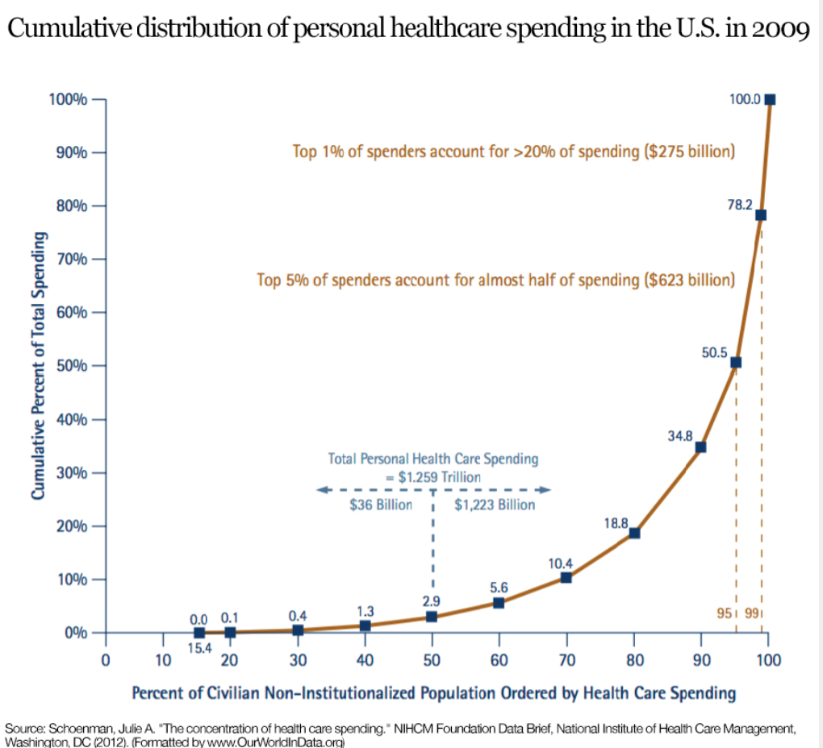

Slide 12
SmarteSoft in Healthcare
Regulatory and testing
Validation, unit, and regression testing
Automatized migration from manual testing to automated
Integration testing
Blood bank and other rigorous Validations, complete with digital signature capabilities
Application maintenance and patch release testing management
HIS investment ROI optimization
Resolution of code instability errors
Build/Mock/Test domain and database reconciliation vs each other or Prod
Database error analysis
System audits and risk mitigation efforts
Assure complete revenue realization
Application quality assurance (SLA governance)
Clinical resource prioritization
Domain population for testing and training purposes
CDS optimization
Protection against potential added legal responsibility associated with remiss software due to increased documentation and error traceability¹
1. Newport Group, Justifying the Purchase of an Automated Testing Tool

Slide 13
Healthcare Case Studies
Ascension Health
85 Acute care facilities, Central and Eastern U.S.
$21BB annual revenue
Smarte QA approach identified and saved 0.46% of revenue annually
Kaiser Permanente
201 Acute care facilities across Western and Central U.S.
Application (Blood Bank, Pharmacy, Laboratory, etc.) upgraded at every facility on an average 18-month interval
Smarte QA approach saved approximately $400K per application upgrade
Tenet Health
Publically-traded 108 Acute care facilities across U.S. and Europe
Smarte QA approach saved $1MM monthly in pharmacy charge errors for each of their Texas facilities

Slide 14
The Healthcare Payer Dilemma
Traceability and Reconciliation
Medicare and Medicaid, MU
Value for service
Unnecessary treatment expenditures
Healthcare Information Systems (HIS, EMR) ever-growing in complexity and scale
Reconciliation between EMR and ERP
Administrative Flux
Back office and BPO continuously changing in an effort to optimize revenue cycles, keep pace with legislative changes
QA resources often re-prioritized
Traditional test automation “tool” schemes require resources that are generally not available in this space; functional testing, manual or automated, not ideal fit for clinicians

Slide 15
The Pharmaceutical Dilemma
Traceability and Validation, Margin
Clinical Trials
To assure outcomes, if processes aren’t soundly validated and traceable neither is the drug
Costs of missteps are astronomical
R&D and Manufacturing
Repeatable, traceable development, testing (Validation) and manufacturing processes are vital
Dispensation
Validation of interaction rule sets (CDS) critical to assure patient outcomes and drug efficacy and profit

Slide 16
Pharmaceutical Case Studies
Cenduit
Global provider of clinical trail services
Specialize in Case Study software employing IRT (Interactive Response Technology) and Randomization
Addition of SpiraTeam (replacing paper and excel) to manage trial requirements software development cycle reduced release times by over 50% while significantly increasing process rigor and traceability
Pfizer
Multi-national drug and drug delivery support systems provider
Optimizing technologies and branding to better-penetrate Acute Care market
Working with client to design and validate drug interaction CDS in infusion pumps
eHealth (Victoria, Australia)
Developed reconciliation scheme for iSoft/Cerner/Pyxis integration
Managed hundreds of thousands of transactions daily, built framework for global SNOMED/Multum interface
Allowed for drug traceability, accurate patient records and accountable and proficient CDS

Slide 17
Services
Support
Advanced technical support staffed by QAA and ALM experts
Training
Training for all Inflectra products
Professional Services
Specialized healthcare capabilities including HIS implementation guidance, patch and regression support, BBV
Broad Pharma and general Validation expertise
Vertical-agnostic turnkey QA and ALM projects
Design
Implementation
Augmentation
Migration, off other platforms or manual processes
Expert consulting on any aspect of QA, Performance Test or ALM projects

Slide 18
Q&A, Discussion

Slide 19
Contact Us
Scott Almeda
SmarteSoft
Main: +1 512.782.0403
Mobile: +1 603.866.0522

